Slide 1
Session#02 TOPIC: Computer Architecture

Slide 2

What computer does do?
The processor can read and write items in the memory according to some list of instructions, while the memory simply remembers the data it has been given. The list of instructions executed by the processor are known as a computer program.
Basically, a machine is universal if it is able to do the following:
Read a value from memory.
Based on the read value, determine a new value to write to memory.
Based on the read value, determine which instruction to execute next.

Slide 3
Computer Architecture
Computer architecture describes how a machine is logically organized and how its instruction set is actually implemented.
One of the most important architectural decision made in designing a computer is how its memory is organized, and how programs are loaded into the machine.
In the early history of computers, there was a distinction between stored program and hardwired computers.
Rewiring a machine simply takes too long when compared to the process of simply loading new data into the machine.
In the current era of computing, almost all computers are stored program computers. In this book, we will be focusing on stored program computer architectures.

Slide 4
Historical Development
The evolution of computing machinery has taken place over several centuries.
The evolution of computers is usually classified into different generations according to the technology of the era.

Slide 5
Continue..
Generation Zero: Mechanical Calculating Machines (1642 - 1945)
Calculating Clock - Wilhelm Schickard (1592 - 1635).
Pascaline - Blaise Pascal (1623 - 1662).
Difference Engine - Charles Babbage (1791 - 1871), also designed but never built the Analytical Engine.
Punched card tabulating machines - Herman Hollerith (1860 - 1929).
Hollerith cards were commonly used for computer input well into the 1970s.

Slide 6
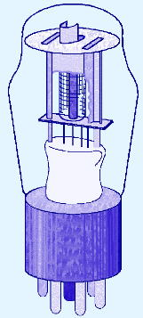
Continue..
The First Generation: Vacuum Tube Computers (1945 - 1953)
Atanasoff Berry Computer (1937 - 1938) solved systems of linear equations.
John Atanasoff and Clifford Berry of Iowa State University.

Slide 7
Continue..
The First Generation: Vacuum Tube Computers (1945 - 1953)
Electronic Numerical Integrator and Computer (ENIAC) by John Mauchly and J. Presper Eckertat the University of Pennsylvania, 1946
The IBM 650 first mass-produced computer. (1955). It was phased out in 1969.

Slide 8
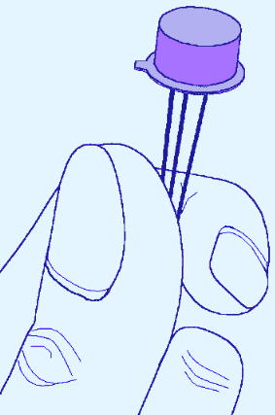
Continue..
The Second Generation: Transistorized Computers (1954 - 1965)
IBM 7094 (scientific) and 1401 (business)
Digital Equipment Corporation (DEC) PDP-1
Univac 1100
Control Data Corporation 1604.
. . . and many others.

Slide 9
Continue..
The Third Generation: Integrated Circuit Computers (1965 - 1980)
IBM 360
DEC PDP-8 and PDP-11
Cray-1 supercomputer
. . . and many others.
By this time, IBM had gained overwhelming dominance in the industry.
Computer manufacturers of this era were characterized as IBM and the BUNCH (Burroughs, Unisys, NCR, Control Data, and Honeywell).

Slide 10
Continue..
The Fourth Generation: VLSI Computers (1980’s)
Very large scale integrated circuits (VLSI) have more than 10,000 components per chip.
Enabled the creation of microprocessors.
The first was the 4-bit Intel 4004.
Later versions, such as the 8080, 8086, and 8088 spawned the idea of “personal computing.”

Slide 11
Continue..
The Fifth Generation: (1985 - Present)
In the fifth generation, VLSI technology became ULSI (Ultra Large Scale Integration) technology, resulting in the production of microprocessor chips having ten million electronic components.
This generation is based on parallel processing hardware and AI (Artificial Intelligence) software.
AI is an emerging branch in computer science, which interprets the means and method of making computers think like human beings.
All the high-level languages like C and C++, Java, .Net etc., are used in this generation.

Slide 12
Continue..
The main features of fifth generation are −
ULSI technology
Development of true artificial intelligence
Development of Natural language processing
Advancement in Parallel Processing
Advancement in Superconductor technology
More user-friendly interfaces with multimedia features
Availability of very powerful and compact computers at cheaper rates
Some computer types of this generation are −
Desktop
Laptop
NoteBook
UltraBook
ChromeBook

Slide 13
Types Of Computer Architecture
Von Neumann Architecture
Harvard Architecture

Slide 14
Von Neumann Architecture
The invention of stored program computers has been ascribed to a mathematician, John von Neumann, who was a contemporary of Mauchley and Eckert.
Stored-program computers have become known as Von Neumann Architecture systems.
Today’s stored-program computers have the following characteristics:
Three hardware systems:
A central processing unit (CPU)
A main memory system
An I/O system
The capacity to carry out sequential instruction processing.
A single data path between the CPU and main memory.
This single path is known as the von Neumann bottleneck.

Slide 15
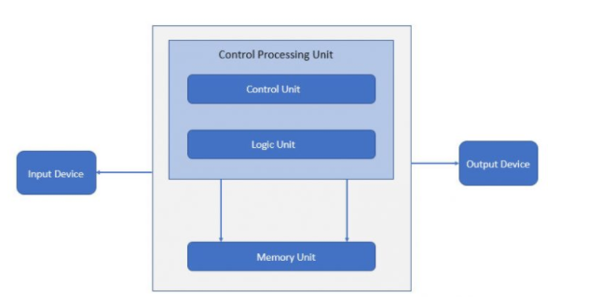
Von Neumann Architecture
The Von Neumann Architecture is, by far, the most common architecture in existence today. PCs, Macs, and even Android phones are examples of Von Neumann computers.
There is a bus (address bus/data bus/control bus) used for the instruction and data code execution.

Slide 16
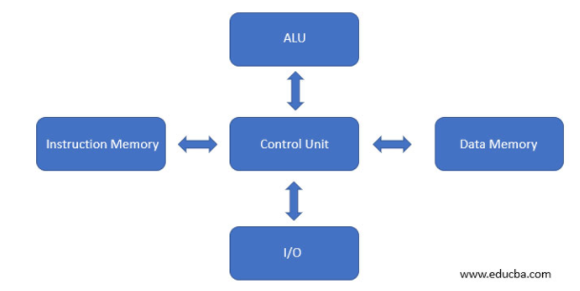
Harvard Architecture
Harvard architecture is used when data and code is present in different memory blocks.
A separate memory block is needed for data and instruction.
Data can be accessed by one memory location and instruction can be accessed by a different location.
It has data storage entirely contained within the central processing unit (CPU). A single set of clock cycles is required.
We can observe in the below image, there are separate data and instruction memory that is a bus available to perform operations.

Slide 17
CA v/s CO
Computer Architecture | Computer Organization
Computer Architecture is concerned with the way hardware components are connected together to form a computer system. | Computer Organization is concerned with the structure and behaviour of a computer system as seen by the user.
It acts as the interface between hardware and software. | It deals with the components of a connection in a system.
Computer Architecture helps us to understand the functionalities of a system. | Computer Organization tells us how exactly all the units in the system are arranged and interconnected.
A programmer can view architecture in terms of instructions, addressing modes and registers. | Whereas Organization expresses the realization of architecture.
While designing a computer system architecture is considered first. | An organization is done on the basis of architecture.
Computer Architecture deals with high-level design issues. | Computer Organization deals with low-level design issues.
Architecture involves Logic (Instruction sets, Addressing modes, Data types, Cache optimization) | Organization involves Physical Components (Circuit design, Adders, Signals, Peripherals)

Slide 18
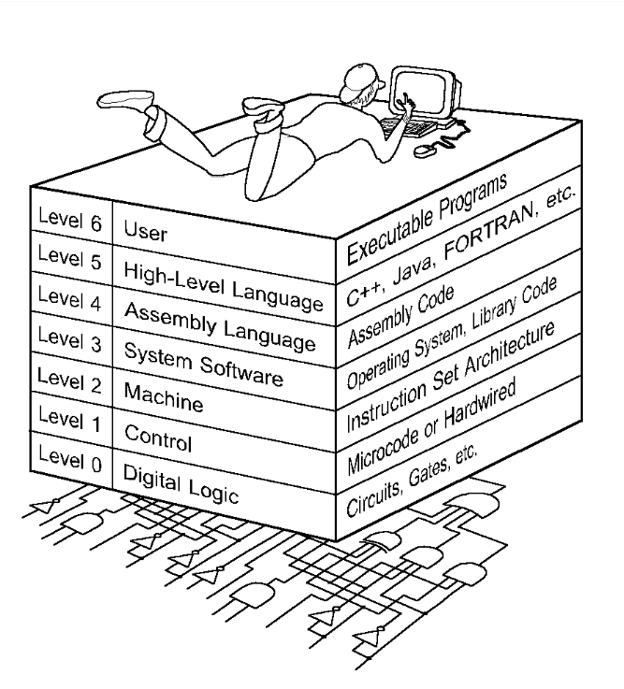
The Computer Level Hierarchy
Each virtual machine layer is an abstraction of the level below it.
The machines at each level execute their own particular instructions, calling upon machines at lower levels to perform tasks as required.
Computer circuits ultimately carry out the work.

Slide 19
The Computer Level Hierarchy
Level 6: The User Level
Program execution and user interface level.
The level with which we are most familiar.
Level 5: High-Level Language Level
The level with which we interact when we write programs in languages such as C, Pascal, Lisp, and Java.

Slide 20
The Computer Level Hierarchy
Level 4: Assembly Language Level
Acts upon assembly language produced from Level 5, as well as instructions programmed directly at this level.
Level 3: System Software Level
Controls executing processes on the system.
Protects system resources.
Assembly language instructions often pass through Level 3 without modification.

Slide 21
The Computer Level Hierarchy
Level 2: Machine Level
Also known as the Instruction Set Architecture (ISA) Level.
Consists of instructions that are particular to the architecture of the machine.
Programs written in machine language need no compilers, interpreters, or assemblers.

Slide 22
The Computer Level Hierarchy
Level 1: Control Level
A control unit decodes and executes instructions and moves data through the system.
Control units can be micro programmed or hardwired.
A micro program is a program written in a low-level language that is implemented by the hardware.
Hardwired control units consist of hardware that directly executes machine instructions.

Slide 23
The Computer Level Hierarchy
Level 0: Digital Logic Level
This level is where we find digital circuits (the chips).
Digital circuits consist of gates and wires.
These components implement the mathematical logic of all other levels.

Slide 24
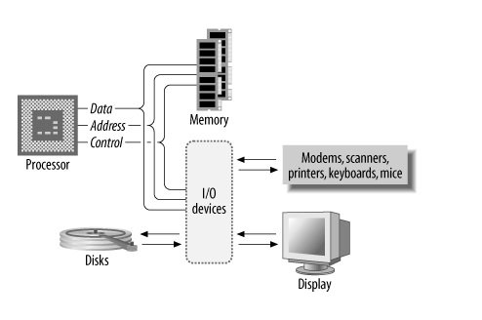
Basic System Architecture
The processor alone is incapable of successfully performing any tasks. It requires memory (for program and data storage), support logic, and at least one I/O device (“input/output device”) used to transfer data between the computer and the outside world.
The basic computer system architecture is shown

Slide 25
Processor
The processor is the most important part of a computer, the component around which everything else is centered.
In essence, the processor is the computing part of the computer.
A processor is an electronic device capable of manipulating data (information) in a way specified by a sequence of instructions.
The instructions are also known as opcodes or machine code .
This sequence of instructions may be altered to suit the application, and, hence, computers are programmable. A sequence of instructions is what constitutes a program.

Slide 26
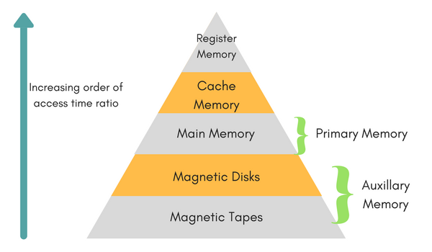
Memory
Memory is used to hold data and software for the processor.
There is a variety of memory types, and often a mix is used within a single system. Some memory will retain its contents while there is no power, yet will be slow to access.
Other memory devices will be high-capacity, yet will require additional support circuitry and will be slower to access.
Still other memory devices will trade capacity for speed, yielding relatively small devices, yet will be capable of keeping up with the fastest of processors.

Slide 27
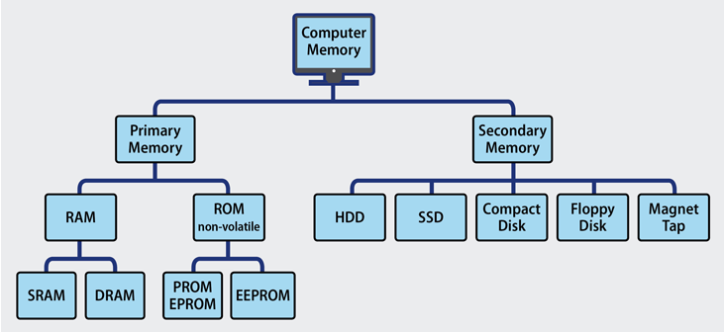
Types of Main Memory

Slide 28
Continue
RAM
It is where the processor may easily write data for temporary storage. RAM is generally volatile, losing its contents when the system loses power.
SRAM
SRAMs use pairs of logic gates to hold each bit of data. SRAMs are the fastest form of RAM available, require little external support circuitry, and have relatively low power consumption.
Their drawbacks are that their capacity is considerably less than DRAM, while being much more expensive.
DRAM
DRAMs are the highest-capacity memory devices available and come in a wide and diverse variety of subspecies.
Most processors with large address spaces include support for DRAMs.

Slide 29
Continue
ROM
ROM stands for Read-Only Memory.
ROMs are nonvolatile memory, requiring no power to retain their contents.
They are generally slower than RAM, and considerably slower than fast static RAM.
The primary purpose of ROM within a system is to hold the code (and sometimes data) that needs to be present at power-up
EPROM
Short for Erasable Programmable Read-Only Memory, EPROM is a non-volatile memory chip that can only be read.
PROM
PROM stands for Programmable Read-Only Memory, during the manufacturing process, a PROM is manufactured in an empty state and then programmed later using a PROM programmer or burner.
EEPROM
EPROM stands for Electrically Erasable Programmable Read-Only Memory, and the distinction between EPROM and EEPROM is that the latter can be erased and written to by the computer system it is installed in.

Slide 30
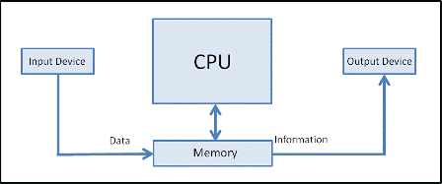
Input/output
The address space of the processor can contain devices other than memory.
These are input/output devices (I/O devices, also known as peripherals ) and are used by the processor to communicate with the external world.
Some examples are serial controllers that communicate with keyboards, mice, modems, etc.; parallel I/O devices that control some external subsystem; or disk-drive controllers, video and audio controllers, or network interfaces.

Slide 31
Conclusion
This chapter has given you an overview of the subject of computer architecture.
Thank you
Q/A

